Slide 1
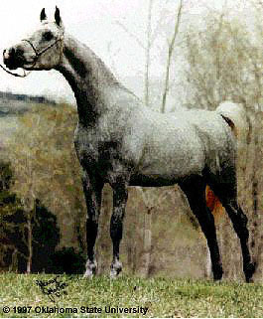
Arabian
Notes:
The Arabian is the oldest purebred horse. It is the foundation horse for several breeds including: the Thoroughbred, Quarter Horse, and Morgan. Its slender frame, compact bone structure, and stamina allow it to excel at endurance racing. The first Arabian in the United States was owned by President George Washington.

Slide 2
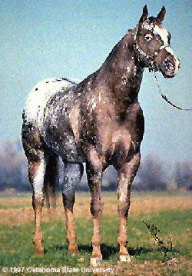
Appaloosa
Notes:
This spotted horse was first bred by the Nez Perce and Palouse tribes of Washington, Oregon and Idaho from horses left by the Spanish explorers. Appaloosas have a mottled or parti-colored skin and coat, the sclera of their eye is white like a human’s eye, and their hooves are striped. This breed is popular because of its flashy appearance.

Slide 3
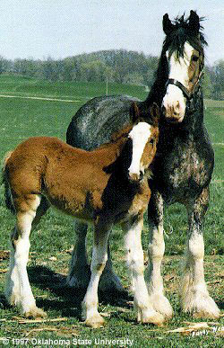
Clydesdale
Notes:
The Clydesdale is a breed of heavy draft horse developed in and deriving its name from the district in Scotland where it was founded. Today they are used in parades and driving contests and are popular recreational horses. Clydesdales are typically seen with bay, black, or brown coats.

Slide 4
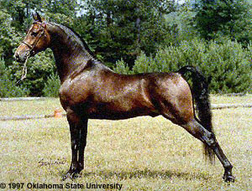
Morgan
Notes:
The Morgan horse was developed in Vermont from a colt named Figure. This breed excels in strength, beauty and speed. It is a popular horse because of its small size and friendly, intelligent temperament.

Slide 5
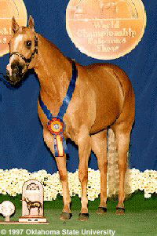
Palomino
Notes:
The Palomino is a color breed, meaning that horses of other breeds with the distinct golden color can also be registered as Palomino. The Palomino color can be found in quarter horses, Saddlebreds, Morgans, Arabians and the Tennessee Walking Horse.

Slide 6
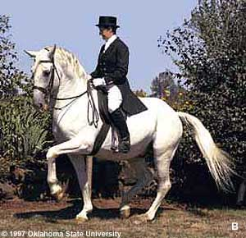
Lipizzan
Notes:
In the 1560’s Arabian horses were crossed with Spanish horses to produce the Lipizzan or “Lipizzaner”. This is the famed horse of the Spanish Riding School in Vienna, Austria. These horse are born dark and gradually turn grey or white between 6 and 10 years old. In very rare cases the horse will remain a dark color. The Lipizzan excels at performing the movements of classical riding.

Slide 7
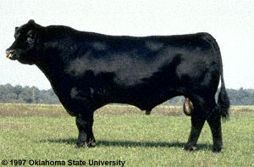
Angus
Notes:
The Angus originated in Scotland and is known as for today’s finest beef products. This breed is naturally polled or hornless and the coat is always black.

Slide 8
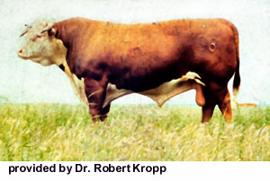
Hereford
Notes:
The Hereford breed was developed in England to fill a need for providing the masses with an economical source of beef. To do this farmers needed as animal that could convert the local forages into beef. Herefords are still one of the most popular beef animals in the U.S.

Slide 9
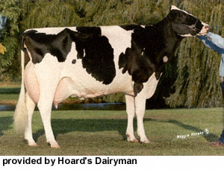
Holstein
Notes:
The Holstein is the highest producing dairy cattle in the U.S. All animals are black and white. They are large animals weighing up to 1500 pounds and standing 58 inches tall.

Slide 10
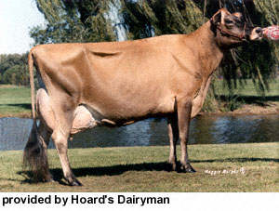
Jersey
Notes:
The Jersey is another popular breed of dairy cattle. They weigh an average of 900 pounds and produce more pounds of milk per pound of body weight than any other breed. Jerseys are also more tolerant of heat than the larger breeds.

Slide 11
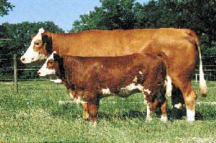
Simmental
Provided by American Simmental Association
Notes:
The Simmental is one of the oldest breeds of beef cattle in the world. It is estimated that there are between 40 and 60 million Simmentals world-wide.

Slide 12
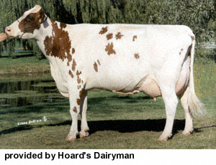
Ayrshire
Notes:
This dairy breed is known for its quality udder and conformation. It is an efficient grazer and milk producer. Ayrshires are always a mottled re and white color.

Slide 13
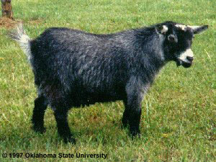
Pygmy
Notes:
This goat originated in French Cameroon in Africa and was first exported to the U.S. in 1959. Adult males have a long and flowing beard. Females may have a sparse beard. All coat colors are acceptable. The muzzle, forehead, eyes, and ears are lighter than the body. Front and rear legs are darker than the main body coat, as are the crown and dorsal strip.

Slide 14
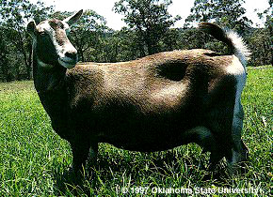
Toggenburg
Notes:
The Toggenburg is the oldest known dairy goat breed, originating in Switzerland. They are noted for their excellent udder development and high milk production It is a medium sized breed. Colors range from dark brown to fawn with white markings on the face, legs and tail.

Slide 15
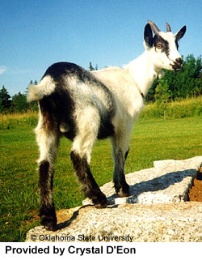
Alpine
Notes:
This goat originated in the Alps. It is used as a dairy animal. There are no specific coat colors or patterns for this goat. Animals range in size from 30-40 inches tall and weigh 135 to 170 pounds.

Slide 16
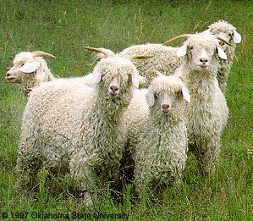
Angora
Notes:
The Angora goat originated in the district of Angora in Asia Minor. Their coats are sheared and made into mohair, a wool-like substance that is smoother and thinner than wool. Coats can be sheared twice a year and yield 5.3 pounds of mohair. Both male and female goats have horns. They are easily mistaken for sheep!

Slide 17
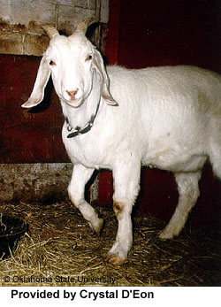
Nubian
Notes:
The Nubian is used for meat, milk and hide production. It is a large goat that originated in Africa. Any solid or parti-colored coat is acceptable.

Slide 18
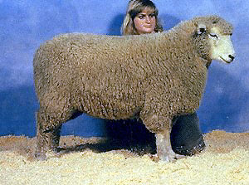
Romney
© Oklahoma State University
Notes:
The Romney is used for meat and fleece production. They are a large sheep, weighing from 150 to 275 pounds. Their fleece is the finest of all the longwool breeds and has a low grease content which makes it ideal for spinning.

Slide 19
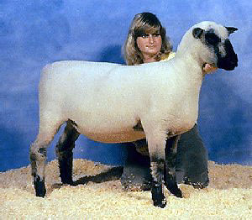
Shropshire
© Oklahoma State University
Notes:
The Shropshire is a medium-wooled breed is used for meat and wool production. It is one of the heaviest wool produces with males producing 10-14 pounds of wool and females producing 9-11 pounds.

Slide 20
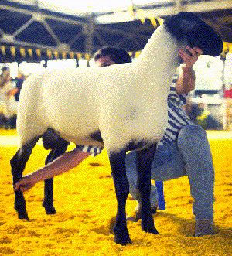
Suffolk
© National Suffolk Sheep Association
Notes:
The Suffolk produces a medium wool fleece. Mature weights for rams range from 250 to 350 pounds and ewe weights vary from 180 to 250 pounds.

Slide 21
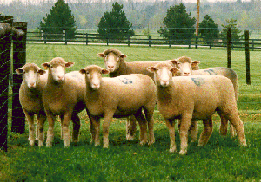
Dorset
© Continental Dorset Club
Notes:
Dorsets can be polled or horned. They are the second most popular breed of sheep in the U.S. outranked only by the Suffolk. They are also used for both meat and wool production.

Slide 22
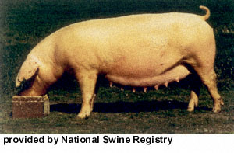
American Landrace
Notes:
This large, long hog must always be white. Black spots eliminate it from being registered. They produce a large amount of meat.

Slide 23
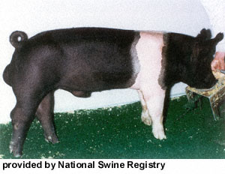
Hampshire
Notes:
This white-belted hog may be one of the oldest original American breeds. They are hardy and efficient producers.

Slide 24
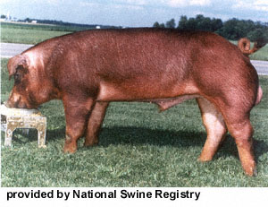
Duroc
Notes:
The Duroc strain of hogs was started in Saratoga County, New York. Color may range from a very light golden color, to a very dark red. The ears should be drooping.

Slide 25
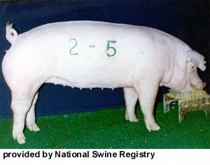
Chester White
Notes:
The Chester White breed originated in Chester County, Pennsylvania. It is a large all white animal.

Slide 26
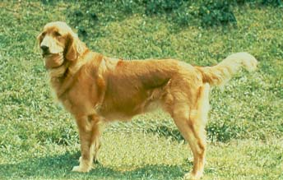
Golden Retriever
Notes:
Sporting Group –
Although Golden Retrievers were originally bred and are still used as hunting dogs, they are being used more and more as guide dogs for handicapped people. Their happy, willing nature makes them well suited for this type of work as well as excellent family pets. The dog has a medium length coat varying in color from light blond to dark gold.

Slide 27
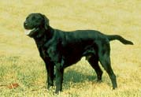
Labrador Retriever
Notes:
Sporting Group –
The Labrador Retriever is another breed that is being widely used as a guide dog. Labs are excellent hunting companions and are well suited to swimming. Their double coats are water repellent and their toes are slightly webbed. Although black is the most common color, Labs can also be blond or chocolate colored.

Slide 28
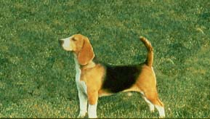
Beagle
Notes:
Hound Group –
Beagles are consistently rated as one of the ten favorite dogs in America because they make fine family pets as well as excellent tracking dogs. They weigh between 20 and 40 pounds with a short coat of tan, white and black markings.

Slide 29
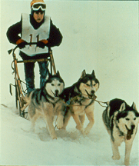
Siberian Husky
Notes:
Working Group –
The Siberian Husky is an ancient breed of draft animal bred to be an endurance runner. In teams, they are capable of pulling a sled over hundreds of miles. The Husky’s soft, double-thick coat provides protection from the harsh environment and varies in shade from white to red to black.

Slide 30
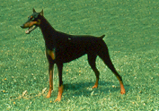
Doberman Pinscher
Notes:
Working Group –
Dobermans are intelligent and agile dogs that were bred to be protectors. They make excellent pets if they are raised with gentleness and proper training.

Slide 31
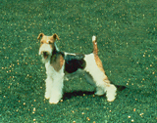
Wire-haired Fox Terrier
Notes:
Terrier Group –
There are two varieties of fox terriers, the Wire-haired and the Smooth Fox Terrier which has a short, flat coat. Both varieties are intelligent, high-strung, playful and need lots of exercise and attention.

Slide 32

Pekingese
Notes:
Toy Group –
The “Lion Dog” was the sacred dog of the emperors of ancient China. Only the royal family was permitted to own a Pekingese. These ornamental dogs weigh less than 14 pounds and have long, luxurious coats which require daily brushing.

Slide 33
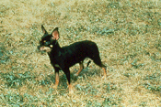
Chihuahua
Notes:
Toy Group –
There are two types of Chihuahua – the smooth coat and the long coat. Both need care and protection from the cold. Chihuahua’s have a very delicate bone structure and should not weigh more than 6 pounds.

Slide 34
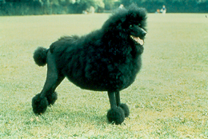
Poodle
Notes:
Non-Sporting Group –
Poodles come in three sizes: standard (shown), miniature, and toy. The Standard Poodle is 15 inches or taller at the shoulder, the miniature is 10-15 inches and the toy is under 10 inches. It can be found in any solid color ranging from black to white.

Slide 35
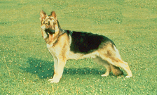
German Shepard
Notes:
Herding Group –
The German Shepherd is a mid-size dog about 22 to 26 inches high and weighs between 60 and 85 pounds. They are bright and sensitive, making good watchdogs and great family pets.

Slide 36
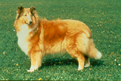
Collie
Notes:
Herding Group –
Collies originated in Scotland and were bred for their ability to herd sheep. The dog shown here is the popular rough-coated variety, but there is also a smooth-coated variety that has very short hair.

Slide 37
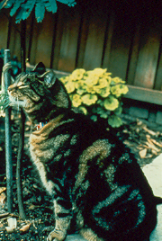
Domestic Shorthair
Notes:
The Domestic Shorthair (DSH) or American Shorthair is the most common type of cat in the United States. This cat shows the very common striped pattern.

Slide 38
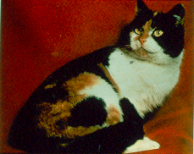
Calico
Notes:
This is also a Domestic Shorthair, but with calico markings which is seen almost exclusively on females. The calico coloring is linked to genetic defects and sterility in male cats.

Slide 39
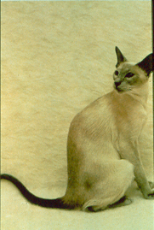
Siamese
Notes:
Siamese are shorthaired cats with a long, slim build. Their distinctive color pattern makes them easy to recognize. The nose, ears, feet and tail, called points, are darker than the rest of the body. Recognized colors are: seal point, blue point, lilac point, and chocolate point.

Slide 40
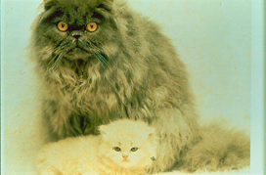
Persian
Notes:
The Persian is a long haired breed with a characteristic pug or pushed in face. Their coloring is solid or mostly solid shades from white to black.

Slide 41
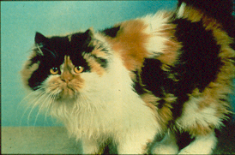
Calico Persian
Notes:
The calico Persian has a calico coat. Again, this coat pattern is rarely seen in males.

Slide 42
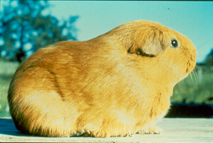
American Cavy
Notes:
The American Cavy, commonly know as the guinea pig, is used in research and kept as pets. Cavies have compact bodies and short legs, but unlike other rodents they lack tails. They can be any solid color or combination of colors. Guinea pigs make great pets.

Slide 43
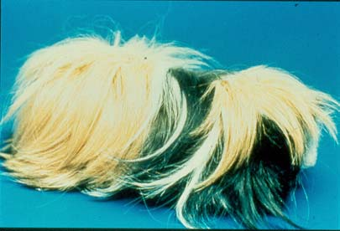
Peruvian Cavy
Notes:
This long haired guinea pig is mainly kept as a pet and show animal. Its long hair requires frequent grooming.

Slide 44
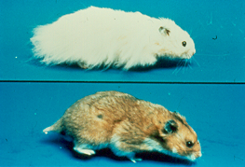
Hamster
Notes:
This rodent has large cheek pouches for storing and carrying food. Their hair can be long or short. Hamsters come in several colors and generally have white bellies. They make entertaining pets.

Slide 45
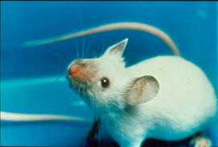
Mouse
Notes:
Domesticated mice can be white, black, brown or multi-colored. They are used in research, as food for other animals, and kept as pets.

Slide 46
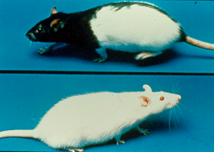
Rats
Notes:
Rats also come in a variety of coat colors and patterns. They are used in research and make intelligent pets.

Slide 47
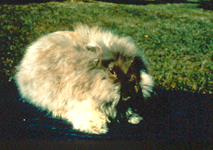
Angora
Notes:
There are several varieties of angoras that are raised for their wool. Angora wool is prized for its insulating capacity. Their wool can be white or another solid color with hairs measuring up to 4 inches in length.

Slide 48
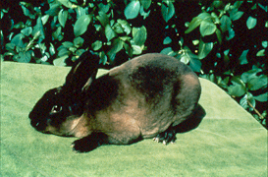
Rex
Notes:
The Rex is raised for its short, plush fur. They come in many solid and broken colors. Broken is the term used to describe any color in combination with white.

Slide 49
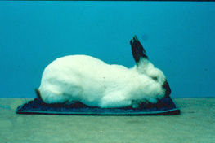
Californian
Notes:
The Californian is used for meat and research. They have white coats with dark noses, ears, feet and tail.

Slide 50
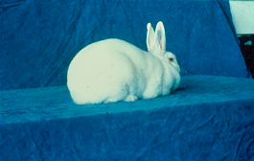
New Zealand
Notes:
The New Zealand is used for meat and research. Its most common color is white with pink eyes, but it can also have black or red fur with brown eyes. The New Zealand has a calm temperament making it a good pet.

Slide 51
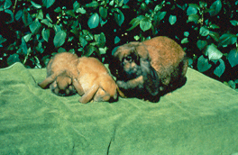
Mini Lop
Notes:
This popular show and pet breed has distinctive ears that lop, or hang down. They come in a variety of solid and broken colors and weigh up to 5 pounds.

Slide 52

Dutch
Notes:
This breed is popular as a show animal and pet. They come in a variety of colors with white over the shoulders and face.

