Slide 1
Bandaging
By C. Kohn
Agricultural Sciences
Waterford, WI

Slide 2
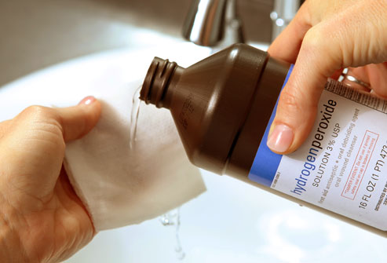
Wound Preparation
Prior to bandaging a wound, the wound itself must be cleansed.
Whenever a wound breaks the skin, an infection can occur.
Bacteria, debris, and even fur can cause wound contamination.
While hemorrhage (bleeding) can flush out a wound, additional wound cleansing may be necessary.
For wounds that aren’t bleeding, cleansing of the wound can reduce the risk of infection.
To begin, clip any fur that may be in the way. This will prevent it from sticking to the injury.
Use your index and second finger to hold the fur against the wound. Cut the fur level with your fingers within 1 inch of the wound.
Use petroleum jelly or a personal lubricant to attract any leftover cut hair.
Rinse the wound with plenty of water to wash away the lubricant and hair.
Source: docakilah.wordpress.com

Slide 3
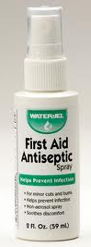
Cleansing Wounds
The best way to cleanse a wound is to flush it with cool water or a sterile contact lens saline solution.
If you do not have sterile saline solution, a garden hose or kitchen sink spray attachment can work too.
After cleansing the wound, use a nonstinging antiseptic solution to disinfect the wound.
An antiseptic solution is one that prevents the growth of microorganisms (such as bacteria) that can cause an infection.
This is different from an antibiotic, which kills bacteria by breaking open the cell membrane, by interfering with the bacterial genes, or by disrupting a critical cellular function such as protein synthesis or cellular respiration.
Antibiotics vs. Antiseptics
Antiseptics can be used generously without impairing their function.
Overuse of antibiotics, however, can lead to antibiotic resistance.
Antibiotic resistance is the phenomenon where the overly-frequent use and misuse of antibiotics has enabled bacteria to develop the ability to overcome the antibiotic mechanism.
This has caused many antibiotics to lose their effectiveness against bacteria, making them useless.
Source: www.waterjel.com

Slide 4
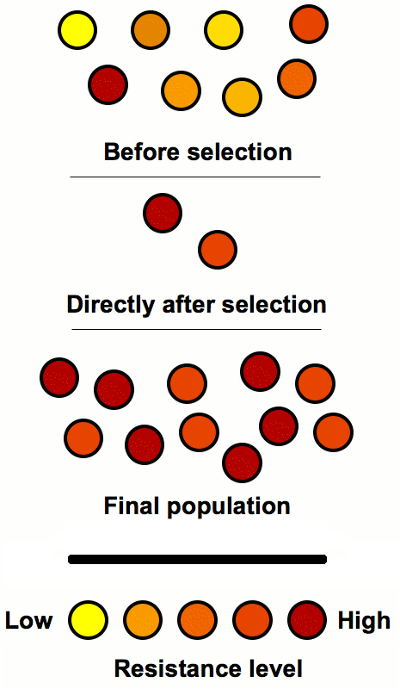
Antibiotic Resistance
The effects of antibiotic resistance can be reduced by…
Not using antibiotics for anything but a bacterial infection.
Antibiotics will do nothing to help a viral infection (such as the common cold).
Use of antibiotics during a viral infection will worsen antibiotic resistance, however.
Only administering an antibiotic if it is prescribed by a medical professional.
When an antibiotic is prescribed, use the full dose for the entire prescription time frame.
Not using the full dose can allow some of the infecting bacteria to regain their strength and overcome the antibiotic mechanism.
Never skip a dosage of antibiotic or end the treatment early.
Seek non-antibiotic methods to treat infections.
Prevention of an infection is a far better method than treatment of one.
Proper bandaging of wounds can lessen the risk of an infection.
Source: withfriendship.com

Slide 5
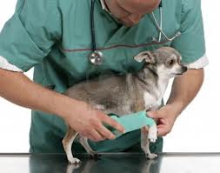
How Bandages Support Wound Healing
Many wounds will heal on their own without bandaging.
A minor, small wound will heal just as well in the open air as with a bandage.
However, for large wounds or wounds with heavy damage, bandage is necessary to support the healing process.
Bandages support the healing of a wound by
Controlling bleeding and aiding hemostasis (platelet plug and fibrin mesh-scab formation).
Absorbing seepage, prevent the build-up of exudate, and protect the wound from infection and drying
Decreasing the possibility of self-trauma & self-inflicted injury
Decreasing swelling and edema (pooling of fluid under the wound)
Bandages reduces the likelihood of scarring.
Bandages prevent desiccation, or the drying-out of the wound.
If a wound dries out, it will take longer to heal and will have a greater risk of infection and scarring.
Decreasing seroma or hematoma formation
Seroma: An accumulation of lymphatic fluid under an incision
Hematoma: a localized swelling filled with blood
Source: Clinical Textbook for Veterinary Technicians 7th ed by McCurnin and Bassert, pgs. 1239-1243, 1249-1264
Source: www.123rf.com

Slide 6
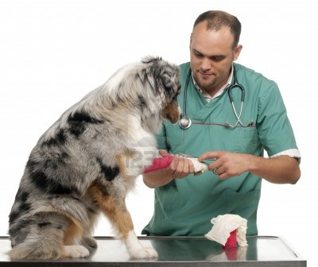
Bandaging Protocols
Proper application and regular changes of bandaging is critical for proper healing.
A bandage must be changed every day or two.
The wound must be kept clean and dry between changes.
If there is swelling above and/or below the bandage, the bandage has been applied too tightly.
This will reduce blood flow and inhibit the healing process.
Bandages should be checked for bad odor regularly as this can be a sign of infection.
For severe injuries, a bandage is only a temporary fix.
A visit to a veterinarian will be necessary.
Source: www.123rf.com

Slide 7
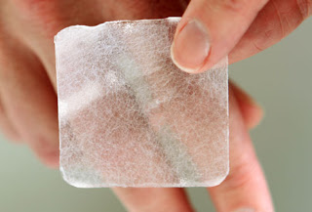
Components of a Bandage
A bandage has three main components: the primary layer (absorbent pad), secondary layer (gauze), and tertiary layer (tape).
Primary layer (or dressing) – the primary layer consists of an absorbent material that is in direct contact with the site of the injury.
The primary layer has the following functions:
Wound Protection
Debridement (removal of dead, damaged, or infected tissue)
Absorption of exudate
A delivery mechanism for topical medication
The primary layer has two key properties: occlusiveness and absorption
Occlusiveness is how well the bandage is able to breathe.
Occlusive dressing is air- and water-tight and forms a tight seal. This can be necessary for wounds that are at high risk for contamination (such as large open wounds or wounds in sensitive areas such as the lungs).
Non-occlusive dressing allows the wound to breathe. This prevents the formation of anaerobic bacteria (bacteria that do not need oxygen).
Source: kahilas.blogspot.com

Slide 8
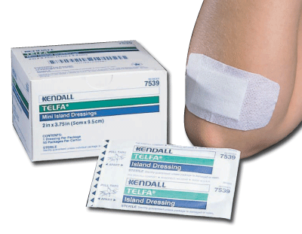
Primary Layer
The primary layer properties determine whether or not a wound has the proper environment in order to heal.
For example, many wounds need a non-occlusive or semi-occlusive primary layer so that the cells of the wound can breathe and reduce the growth an anaerobic bacteria.
However, for abdominal or chest wounds, or for nail avulsions, an occlusive bandage is necessary to prevent a serious infection.
The primary layer should be made of a sterile, nonstick absorptive substance.
Materials that are absorbent, sterile, and lint-free will work.
Clean cotton, tefla nonstick pads, and even diapers or tampons can work for this component of the bandage.
Materials that are paper-based should be avoided for the primary layer as the wound’s granulation tissue will grow into the material.
When the bandage is removed, it will take some of the healthy granulation tissue with it.
Petroleum or KY Jelly can help prevent the wound from sticking to the absorbent pad and will reduce the likelihood of infection.
However, antibiotic ointments should not be used unless there is a serious risk of infection.
Overuse of antibiotic ointments contributes to the problem of antibiotic resistance.
Source: www.hortonandconverse.com

Slide 9
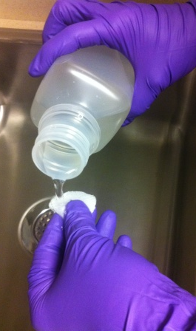
Dressing Types
There are many kinds of primary layer dressing options to choose from. These include…
Dry dressing: dry dressing is composed of a gauze absorbent pad.
These work best for wounds with small amounts of thin exudate.
These will stick to wounds with heavy exudate or wounds with exposure to an outdoor environment.
If a dry dressing does stick to or heal into the wound, saline solution can help free the pad as it is being removed.
Wet-to-dry dressing: these are used for wounds that need debridement (break down of necrotic tissue and exudate).
This type of dressing is made by soaking gauze or cotton in saline.
As the dressing dries, it pulls exudate from the wound.
These dressings are non-selective as they debride the wound; this means that they may absorb healthy granulation tissue as well as exudate and necrotic tissue.
Wet-to-dry dressings also require very-frequent bandage changes, making them time-consuming and expensive.
Healthy tissue around the wound can also become swollen due to the moisture. This may enlarge the size of the wound and possibly enable the spread of infectious bacteria from the wound.
Source: www.angiologist.com

Slide 10
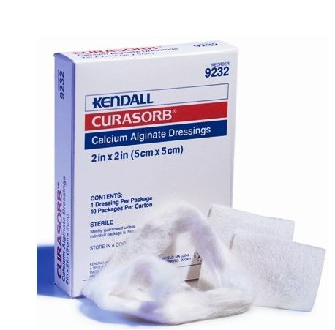
Dressing Types
Foam Dressings: some dressings have foam padding to protect susceptible wounds.
Chemical-impregnated dressings: these are primary-layer materials or topical substances that are pre-treated with chemical agents that speed up stages of wound repair.
Examples include Betadine sheets, petroleum jelly, antibiotic ointments, silver, and collagen.
These dressings are usually applied in addition to an absorbent pad or are already present on specially-designed absorbent pads.
These dressings can be costly and can possibly cause allergic reactions in some pets.
Alginate Dressings: these dressings have calcium, calcium- or sodium-salts, algae, or seaweed within the gel dressing.
These work well for wounds with excessive exudate such as ulcers, deep wounds, severe burns, surgical wounds, and heavily-bleeding wounds.
The active ingredients in these dressings support the cellular processes of hemostasis and healing, including increasing the amount of collagen-producing fibroblasts and capillary tissue in the granulation tissue of the wound.
Source: www.mountainside-medical.com

Slide 11
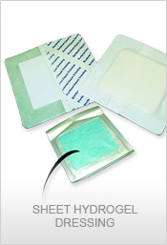
Dressing Types
Hydrofiber dressing: like alginate dressing, these are a form of hyper-absorptive dressing.
However, these dressings do not affect the cellular hemostatic processes.
Instead, these dressings can swell and expand to absorb more exudate.
Transparent Film Dressing: these dressings use a thin layer of film to provide an impenetrable barrier to the environment to reduce the likelihood of infection.
They are semi-occlusive (they do allow some oxygen exchange).
These are not recommended for infected wounds but work well for avulsion wounds.
Hydrogel dressings: these dressings encourage debridement when large amounts of dead tissue are present.
These dressings are used for wounds with necrosis (dying tissue), infection, moderate amounts of exudate production, and in cases where a moist environment is needed.
These dressings are costly and need to be changed every day.
Source: www.glogster.com

Slide 12
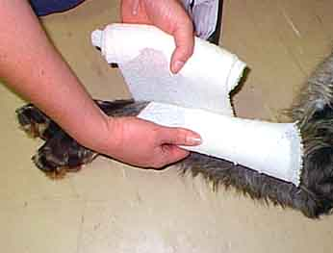
Secondary Layer
Secondary Layer: this component of the bandage determines the amount of pressure that supports the wound.
It also protects and possibly immobilizes the affected area.
The thickness of the secondary layer is determined by the amount of exudate that the wound is expected to produce and the amount of padding and protection needed for the wound.
The more the wound will seep, the thicker the secondary layer should be.
Wounds in highly disrupted areas (such as joints and limbs) require more padding and protection.
Wrappings of gauze are typically used for the secondary layer.
Gauze supports the primary layer, holding it securely in place.
It provides adequate pressure on the primary layer so that it can absorb as much seepage as possible.
If gauze is not available, any elastic and breathable material will work.
This could include a clean sock, panty hose, or elastic fabric.
Source: home.exetel.com.au

Slide 13
Secondary/Tertiary Layer
The secondary layer should be applied in a spiral-wrapping manner around the affected area.
The secondary layer material should overlap by 1/3-1/2 of its width with each wrap.
The material should be wrapped securely but not so tight that you could easily fit two fingers underneath.
The secondary layer should completely touch the primary layer but should not be so tight that the pressure limits the ability of the pad to absorb the seepage.
Tertiary Layer – like the secondary layer, the tertiary layer supports the primary layer and provides protection and possibly immobilization.
Typically the tertiary layer is made of a porous tape.
Fluid from the primary and secondary layer can evaporate if the tape that is used is porous.
This evaporation will pull the exudate from the wound and concentrate it in the primary and secondary layers, reducing the chances of infection in the wound.
Source: http://cal.vet.upenn.edu/projects/saortho/chapter_15/15F4.jpg

Slide 14
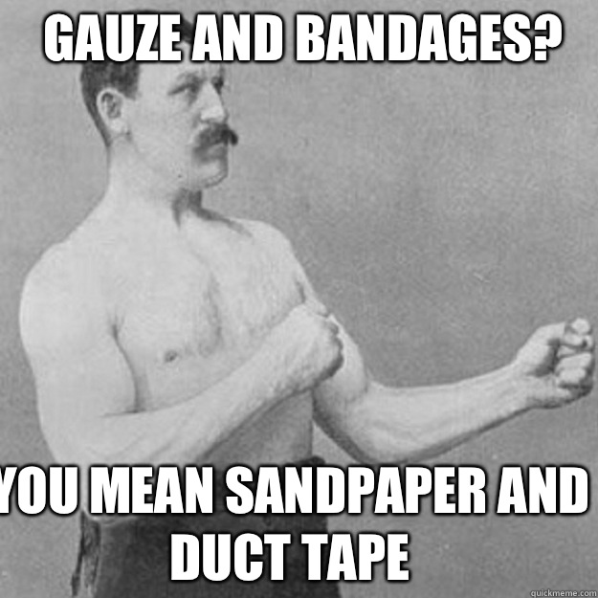
Tertiary Layer
The tertiary layer could also be made up self-adhesive gauze (such as vet-wrap) or even household items such as Saran Wrap.
The use of occlusive (non-porous) materials should be used with caution as it can lead to excessive moisture retention.
If an occlusive material is used (such as Saran Wrap or duct tape), the bandages must be checked very frequently and changed often.
This is especially true for paw-bandages, where sweat from the foot pads adds moisture already present from exudate.
The tertiary layer should extend outside of the secondary layer.
If using tape, the tape should cover a portion of the fur on both sides of the bandage so that it will anchor it in place.
As with the secondary layer, the tertiary layer is too tight if you cannot easily slip two fingers underneath.
Source: www.quickmeme.com

Slide 15
Wound Closure Materials
Wound-closure materials: sutures, staples, and synthetic glue can all be used to close the edges of a wound if the body is not able to accomplish this on its own.
Due to the size of a wound or because of an inability to heal because of physical disruptions, additional materials may be necessary to physically hold the two edges of a wound together.
Sutures (or stitches) are made from a variety of materials and literally “sew” the edges of a wound together.
While sutures are relatively inexpensive and less complicated than staples, they also cause a larger inflammatory response and are more likely to lead to scarring.
Source: gardenrain.wordpress.com

Slide 16
Staples & Glue
Staples provide a quick method for closing a wound and works similar to how an office stapler keeps two pieces of paper together.
Staples are made of stainless steel, which causes less of an inflammatory response than traditional suturing materials.
Staples can also be made of disposable plastic.
Stapling also requires minimal skin penetration compared to suturing, reducing the risk of infection.
However, staples are more expensive than suturing and require skill and care to apply properly.
Synthetic glue (or adhesive) is a third option to close a large wound.
A glue will have the least inflammation if used superficially (only on the surface).
Because of this, scarring is also minimized when glue is used appropriately.
However, glue may not have the strength necessary to ensure wound closure and should only be used for straight wounds under 5 cm long.
Source: terrierlover.com

Slide 17
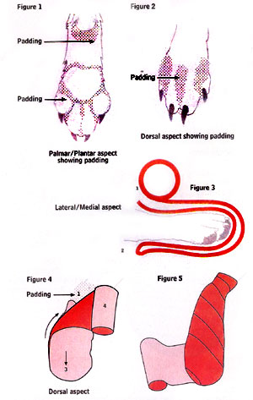
Special Techniques
Paws and Paw Pads: this area is highly susceptible to infection.
First clean, disinfect, and dry the affected paw.
Next place the pet’s wounded paw on an absorbent pad.
Place a length of gauze under the paw and bring over the top of the foot. Repeat.
Wrap around the paw with gauze multiple times.
A pencil should be able to easily fit between the skin and the gauze.
Secure only the top of the gauze with tape so that the bandage can breathe.
Place a small clean sock over this bandage and secure at the top with tape.
Source: www.basc.org.uk

Slide 18
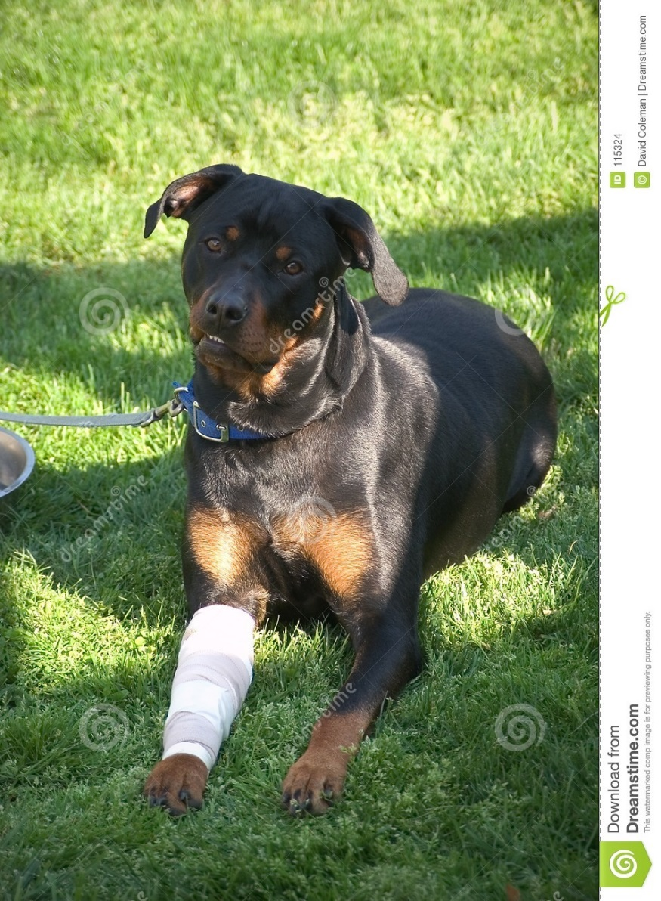
Special Techniques
Legs: bandage the same way as the paw.
Apply an absorbent pad to the wound and secure it by wrapping gauze around the leg.
Tape on both sides of the wound to secure the pad and gauze in place.
Cut the toes off of a clean sock and slip the sock over the bandage.
Secure the sock in place with tape.
Source: www.dreamstime.com

Slide 19
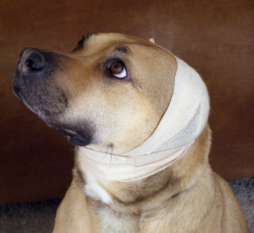
Special Techniques
Ears: if one or both ears are injured, the entire head should be bandaged.
Fold the ears over the top of the pet’s head.
The ears should form a “cap” on top of your dog’s head.
Place a gauze pad or adhesive bandage over the injured portion.
Secure the ends together with tape.
Wrap roll gauze over the ears and over the head, securing under the jaw.
If you do not have gauze, the clean sleeve of an old cotton t-shirt could work too.
Tape the gauze or fabric in place on both ends.
Source: www.justanswer.com

Slide 20
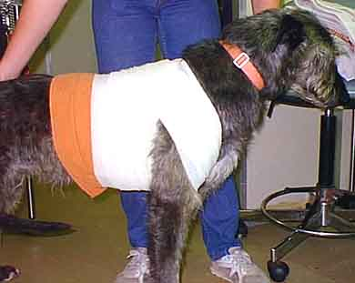
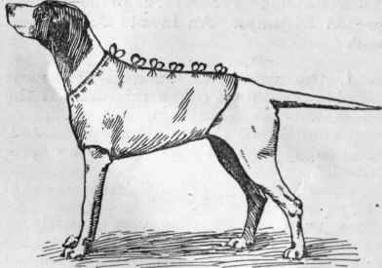
Special Techniques
Chest/Shoulders: begin by positioning a pad over the injury.
Secure the pad in place by wrapping gauze in a figure-8 pattern over the chest or back and around the legs.
Secure in place with tape.
Hips: begin by positioning a pad over the injury.
Secure the pad in place by wrapping gauze in a figure-8 pattern over the back and around the legs.
Secure in place with tape.
Stomach/sides/back: use a clean cotton t-shirt, towel, or table cloth.
Put the animal’s head through the neck-hole and front paws through the arm-holes.
Tape around the waist. Tighten if needed using safety pins or cut the shirt to make straps you can tie.
Source: home.exetel.com.au
Source: chestofbooks.com

