Slide 1
Cat breeds

Slide 2
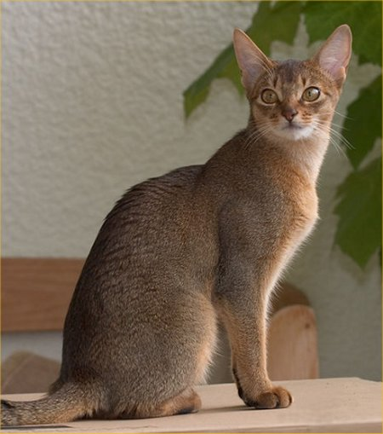
Abyssinian
Balanced medium sized animal of foreign type.
Beautiful ticked, resilient coats
Four common colors: Ruddy, Red, Blue and Cream

Slide 3
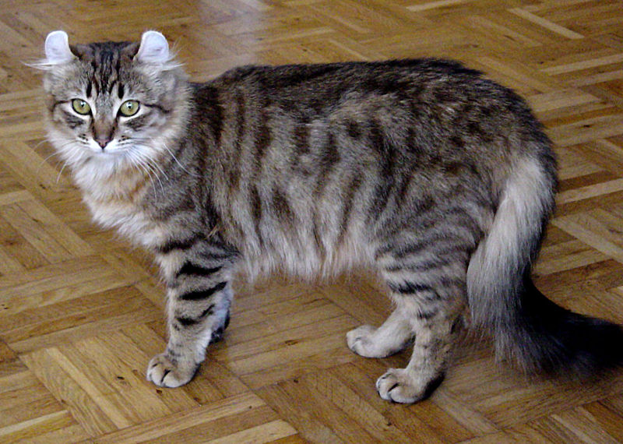
American Curl
Medium sized, alert animals with an elegant appearance and a sweet, open expression complimented by their remarkable ears
Available in long haired and short haired and come in any color or coat pattern

Slide 4
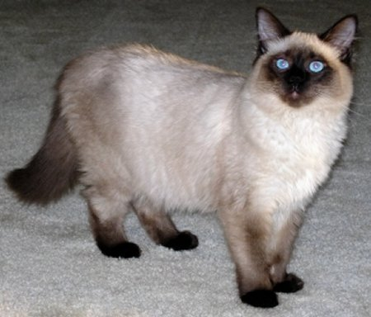
Balinese
Coat is of medium length, and very silky and fine
Solid point colors: seal, blue, chocolate, lilac, red point, cream point, lynx and tortie

Slide 5
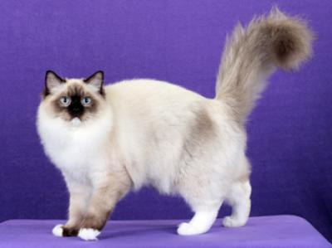
Birman
Average sized cat
Medium length coat
Pointed cats with white paws
Eyes are always blue
Body should be eggshell color or golden depending on markings

Slide 6
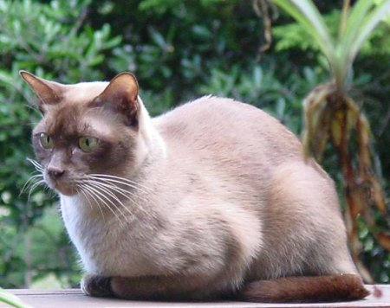
Burmese
Medium sized cat with a rounded head, expressive eyes and a sweet disposition
Many colors are recognized, but the 4 main ones are sable, champagne, blue and platinum

Slide 7
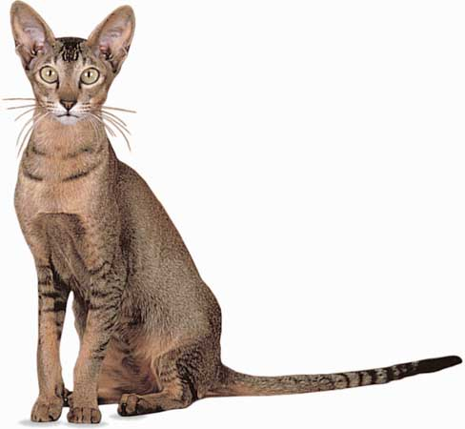
ColorPoint Shorthair
Appear in red point, cream point, lynx point and tortie point
Personality is highly interactive, devoted, playful, and fun-loving

Slide 8
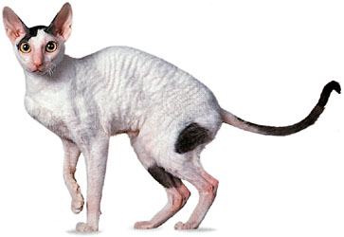
Cornish Rex
Soft, wavy, curly hair
Coat feels like crushed velvet to the touch
Slender, racy bodies
Found in a wide variety of colors and patterns

Slide 9
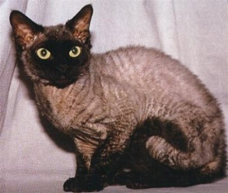
Devon Rex
Soft, short, naturally curly coat
Personality is like there appearance, impish, clever, enterprising and outgoing
Wide variety of patterns and colors

Slide 10
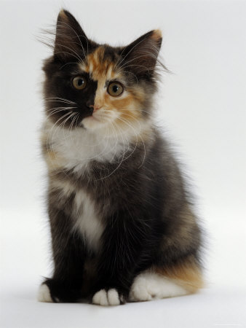
Domestic Longhair
Heavier body and dense overcoat and coarser hair
Any color pattern
Needs daily grooming and house cleaning

Slide 11
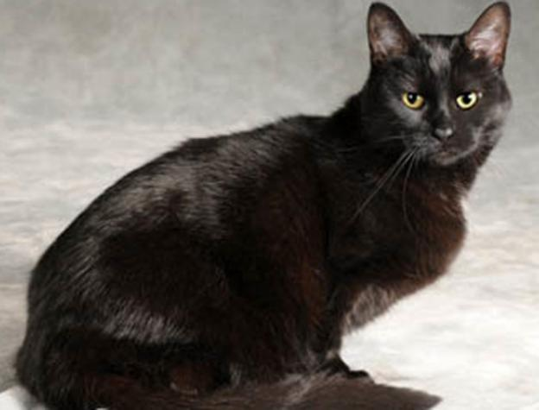
Domestic Shorthair
Wide range of coloring
Not purebred cats, but are of mixed ancestry

Slide 12
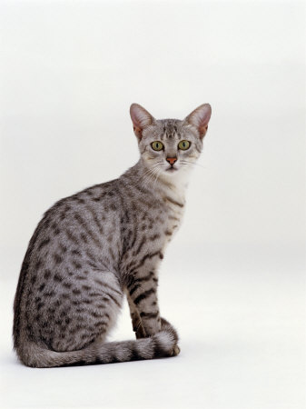
Egyptian Mau
Active, athletic cats have the randomly spotted tabby pattern resembling wild cats
Come in colors such as bronze, silver, and black smoke
Fastest breed of domestic cats

Slide 13
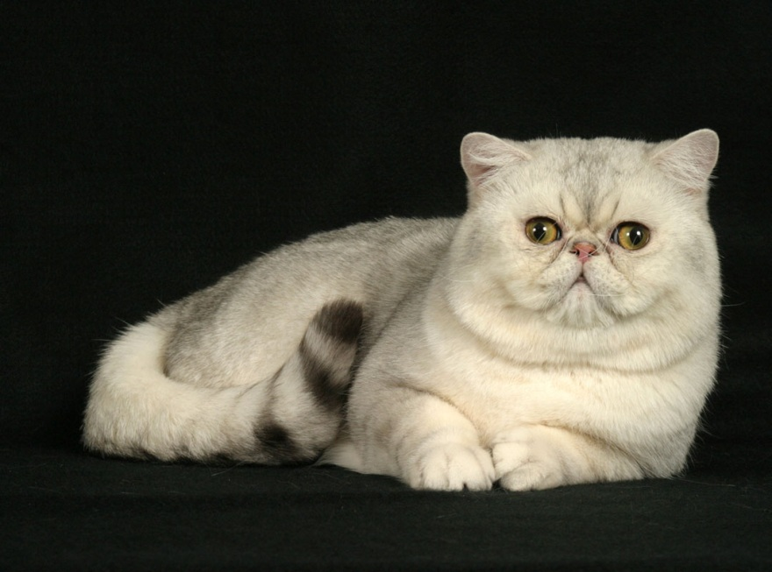
Exotic Shorthair
Cross between Persians and various other shorthaired breeds
Found in the same wide variety of colors and patterns as the Persians

Slide 14
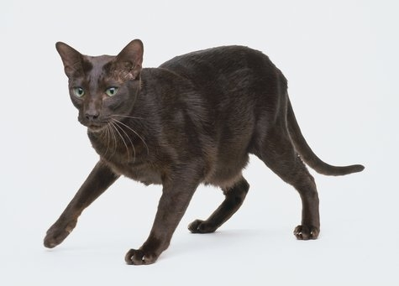
Havana Brown
Noted for its warm, chocolate brown color
Most are chestnut brown, although a lavender frost color is also seen
Very rare breed

Slide 15
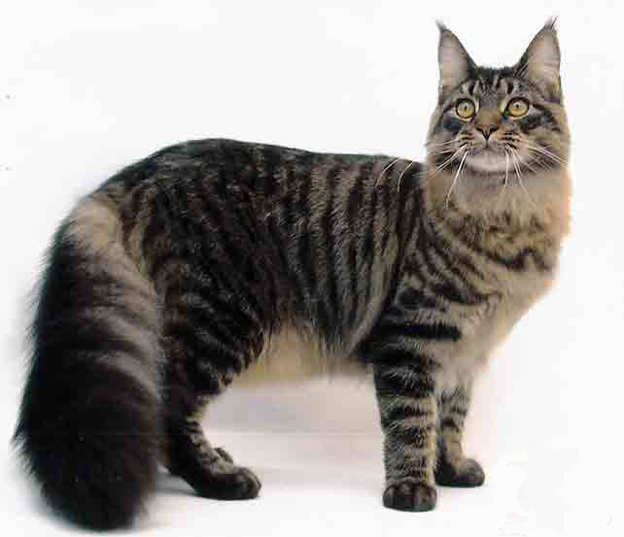
Maine Coon
Head is slightly longer than it is wide, ears are wide at the base, moderately pointed and well tufted inside
Wide range of colors and patterns
Tail is as long as torso

Slide 16
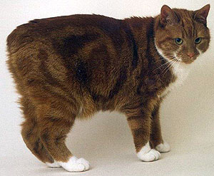
Manx
Stocky, solid cat with a dense double coat, a compact body, very short back, hind legs that are visibly longer than front legs, big bones, wide chest and greater depth of flank
All colors and patterns exist in both coat lengths

Slide 17
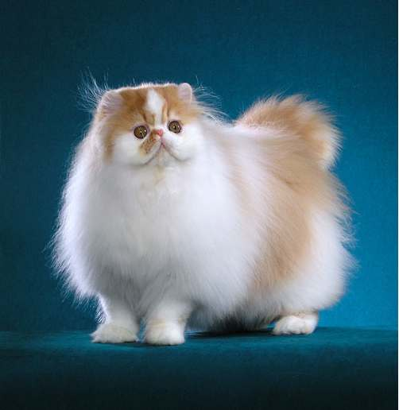
Persian
Available in a veritable rainbow of colors and patterns
Most popular and perhaps the most recognized breed of cats

Slide 18
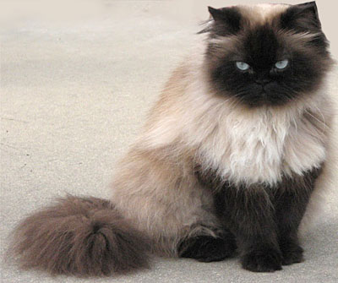
Persian
Himalayan
Identical in type to the Persian, with the exception of its blue eyes and point coloration
Fur of the body is white or cream, but the points come in many different colors such as seal, blue, lilac, chocolate, red and cream

Slide 19
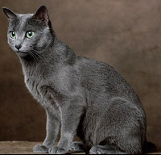
Russian Blue
Noted for its short, plush, silvery blue coat, brilliant green eyes and semi-foreign body type with long legs and body
Solid silvery blue coats

Slide 20
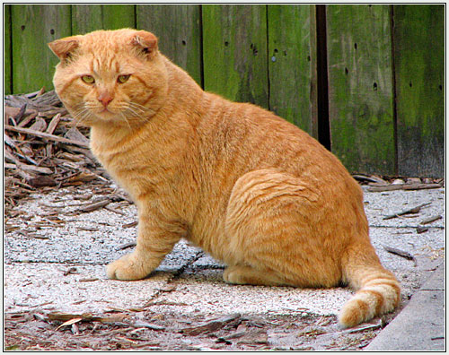
Scottish Fold
Best known for its distinctive ears, which are folded forward and down, and by its large rounded eyes
Great number of colors and patterns

Slide 21
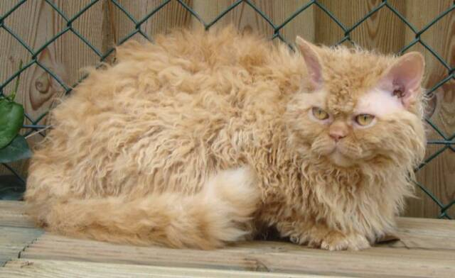
Selkirk Rex
Naturally curly coat
Rounded, stocky body type
Wide variety of colors and patterns
Coat should be soft and curly, with random curling rather than a patterned wave or marcelling pattern

Slide 22
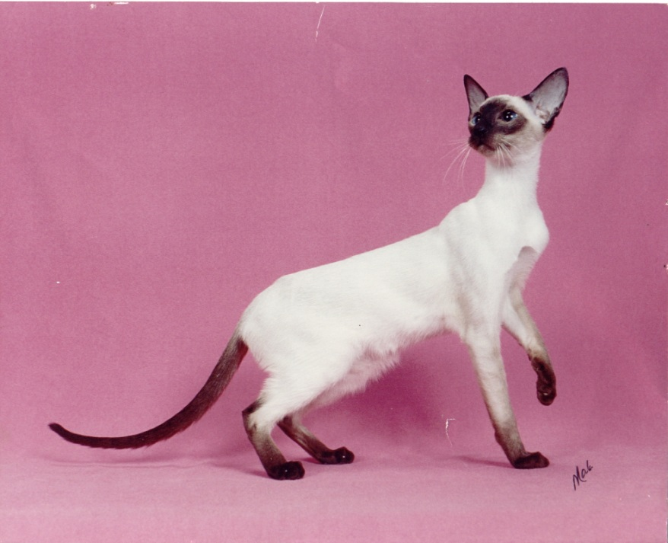
Siamese
One of the oldest recognized and established breeds of cats
Distinguished by its brilliant blue eyes and its colored points which provide contrast to its light colored body.

Slide 23
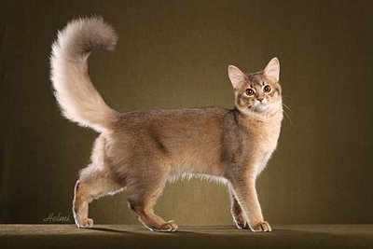
Somali
Longhaired Abyssinian
Commonly available in blue, fawn, red and ruddy
Has a bushy tail

