Slide 1
WRITE your thoughts!
Welcome to Class!
-Can you think of any words, phrases or ideas that people may be confused or misinformed about? List a few.
Notes:
MOTIVATION:
Ask students to read the question and respond on a piece of paper or in a journal.
Give class ~1 minute to read and respond
Ask students, “What did you write down?” quickly discuss some of their ideas and add some of your own.
Some good examples are that many people think that:
-FFA stands for “Future Farmers of America”, it no longer does.
-All Texans ride tractors and horses to school, they do not.
-The word cow represents all sexes of cattle, it actually only represents a previously bred female. (a steer, bull, heifer or calf is not the same as cow)

Slide 2
WRITE your thoughts!
-THINK: What about the idea of animal welfare and animal rights?
-WRITE: Do you think animal welfare and animal rights are the same thing? Why or why not? How do you define these concepts?
Notes:
MOTIVATION continued:
Ask students to read the second question and to again, write a written response.
Give class ~1 minute to read and respond.
Ask students, “What did you write down?” quickly discuss some of their ideas and add some of your own, explaining that “Animal rights is a different concept than animal welfare.”

Slide 3
Pre-Quiz answer these questions on a sheet of scratch paper.
A
I only eat free range eggs, I believe in ___________.
I think that it is wrong to eat meat because it is cruel to animals, I believe in ____________.
My rabbit is kept in a large cage with lots of room to move around in, I believe ____________ is very important
Keeping animals in zoos is unethical, I believe in _________.
I won’t ever buy a pet from a breeder who breeds their female too often because it is unfair. I believe in ____.
I believe in _________. Humans should not be forcing animals to do tricks for our entertainment.
Animal welfare B. Animal rights
B
A
B
A
B
Notes:
MOTIVATION
Students should answer the 6 questions in their journal or on a sheet of paper. After the class is done, review the answers with the class. This should evaluate how much the class already knows about the topic.

Slide 4
Animal Rights and Animal Welfare
Animal Rights and Animal Welfare Unit Part 1
I’m eager to learn!

Slide 5
Today we will…
Identify the differences between animal rights and animal welfare
Define animal rights and animal welfare
Examine examples of animal rights/welfare advocacy and promotion
Research current issues in animal rights and animal welfare

Slide 6
Contrary to popular belief, rights and welfare are NOT the same idea!
Animal Rights
Based on the philosophy that all animals have equal rights with humans. This involves not using animals (or their byproducts) for food, clothing or as pets.
Animal Welfare
Based on the science of well-being and productivity of an animal. This involves the humane treatment of animals.

Slide 7
Animal Rights
Animal Rights, as defined by PETA: (People for the Ethical Treatment of Animals, PETA, is the largest animal rights organization in the world.)
“People who support animal rights believe that animals are not ours to use for food, clothing, entertainment, experimentation, or any other purpose and that animals deserve consideration of their best interests regardless… regardless of whether any human cares about them at all.”
Notes:
http://www.peta.org/about/faq/What-do-you-mean-by-animal-rights.aspx

Slide 8
Animal Rights
Another definition of animal rights:
“Humans have no moral justification for using nonhuman animals for human purposes, however humanely animals are treated. ”
The goal of animal rights is to abolish animal use.
Notes:
http://vimeo.com/4808086

Slide 9
Animal Welfare
Animal Welfare, as defined by the AVMA: (The American Veterinary Medical Association, AVMA)
“Animal Welfare is a human responsibility that encompasses all aspects of animal well-being, including proper housing, management, disease prevention and treatment, responsible care, humane handling, and, when necessary, humane euthanasia.”
Notes:
https://www.avma.org/KB/Resources/Reference/AnimalWelfare/Pages/default.aspx

Slide 10
Animal Welfare
Another definition of animal welfare:
“It is morally acceptable to use nonhuman animals for human purposes as long as we treat them humanely and do not impose unnecessary suffering on them.”
The goal of animal welfare is the regulation of animal use.

Slide 11
Visual Impact?
View this Video posted by PETA.
How does it make you feel?
How might it influence the public?
Click to play!
Notes:
Video can be found at PETA’s YouTube channel: http://www.youtube.com/watch?v=-KONb-xSZvg&list=PLV2RDOhiGtcRplpAKH4Id5lsSoXqXqJX_
DISCUSSION:
Ask students, the displayed questions. Allow for discussion.
**This video should bring up discussion but there is no right or wrong answer or opinion regarding this subject!**

Slide 12
Visual Impact?
View this Video posted by The Humane Society of The United States.
How does it make you feel?
How might it influence the public?
Click to play!
Notes:
Video can be found at HSUS’ YouTube channel: http://www.youtube.com/watch?v=BF3KQ71qp3M
DISCUSSION:
Ask students, the displayed questions. Allow for discussion.
**This video should bring up discussion but there is no right or wrong answer or opinion regarding this subject!**

Slide 13
Rights or Welfare?
I believe using animals for our benefit is wrong!
I believe all animals should be treated humanely!
Tommy Wright
Sally Wellfair
Notes:
APPLICATION:
Students should be able to identify that Tommy Wright believes in animal rights and that Sally Wellfair believes in animal welfare.

Slide 14
WRITE your thoughts!
-Do you have a different definition of these two concepts now?
-How would you define animal rights and animal welfare now?

Slide 15
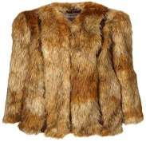
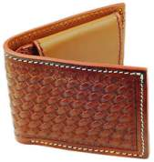
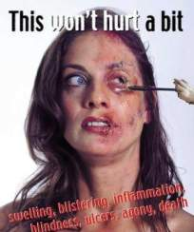
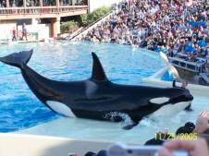
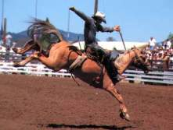
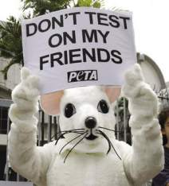
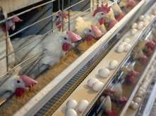
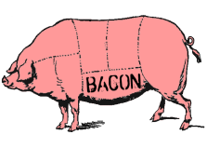
Current Issues in Animal Rights
Fur and Leather production
Entertainment animals
Food Animals
Animal Testing
Notes:
AVMA issues- https://www.avma.org/advocacy/stateandlocal/pages/state-issues-welfare.aspx
Ag Alliance Issues- http://www.animalagalliance.org/current/home.cfm?Category=Current_Issues&Section=Main

Slide 16
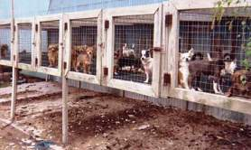
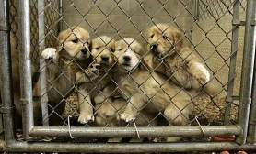
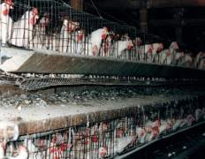
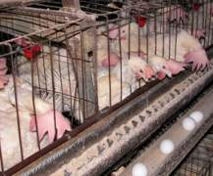
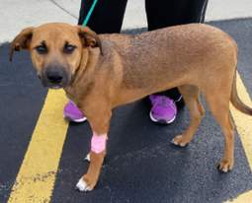
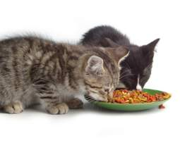
Current Issues in Animal Welfare
Pet sales (Puppy mills)
Egg production (hen housing)
Companion animal care
Notes:
There are many more issues. These three are the most common related to small animals.

Slide 17
Today we…
Identified the differences between animal rights and animal welfare
Defined animal rights and animal welfare
Examined examples of animal rights/welfare advocacy and promotion
Researched current issues in animal rights and animal welfare

