Slide 1
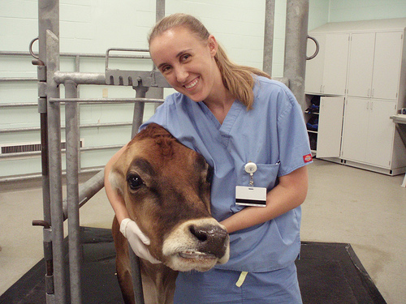
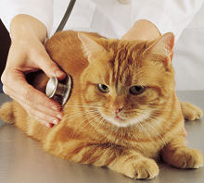
Performing a Physical Exam
Copyright 2010 PEER.tamu.edu

Slide 2
The Procedure
To ensure that a complete physical exam is performed, the veterinary must be consistent in his or her procedure.
To the right is a list of procedures routinely performed during a physical exam; attempt to put them in an appropriate order.
vital signs
thorax
Signalment
head & neck
History
external genitalia
initial observations
trunk & limbs
Socialization
abdomen
Notes:
You could either have students individually write the correct order down or have the entire class work together to come up with the correct order.
Most veterinarians have an individual technique when performing a physical exam so answers could vary. The correct order based on the “Physical Exam” Power Point presentation is: signalment, history, initial observations, socialization, vital signs, head & neck, trunk & limbs, thorax, abdomen, external genitalia

Slide 3
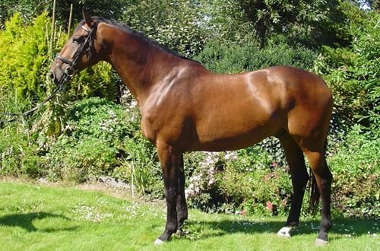
Which One Is It?
Using the case study from the following slide work with a partner and distinguish the signalment from the history.
Notes:
The signalment includes species, breed, sex, & age:
The history includes environment, diet, reproductive history, medical history, vaccination status, & current medications:

Slide 4
Signalment & History
Case Study
10 year-old Bay Dutch Warmblood gelding used as a show jumper.
Stall adjoining an indoor arena, turned out 1-2 hours/day
Fed 2 flakes of Timothy hay + 3 lbs of sweet feed 3x daily.
Vaccinations current & dewormed every 8 weeks
Presented to clinic for being off-feed and refusing jumps
Notes:
Signalment: horse, Dutch Warmblood, male, 10 years.
History: gelding, stalled next to an indoor arena, turned out 1-2 hours/day, fed 2 flakes of Timothy hay and 3 lbs sweet feed 3x/day, vaccinations current and dewormed every 8 weeks

Slide 5
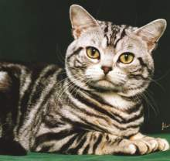
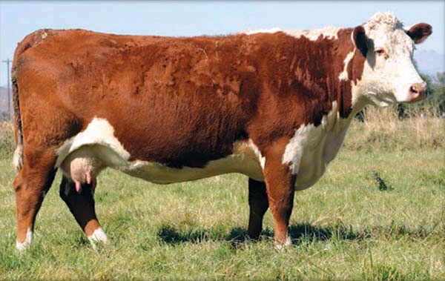
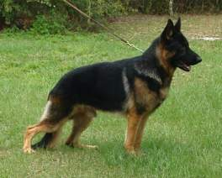
The Importance of Signalment & History
Allows the veterinarian to narrow down the types of diseases or conditions the animal might have
In this case the veterinarian can rule out any diseases that don’t affect adult, gelded, horses

Slide 6
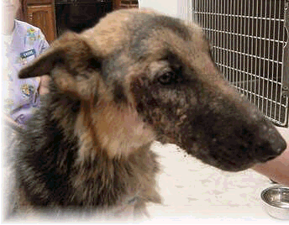
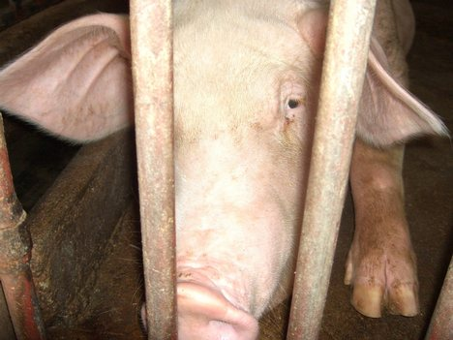
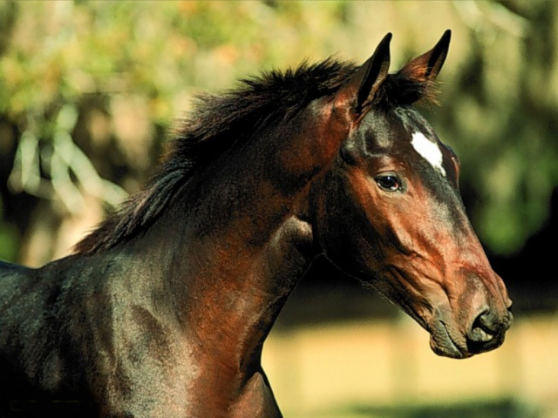
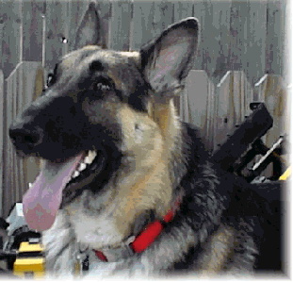
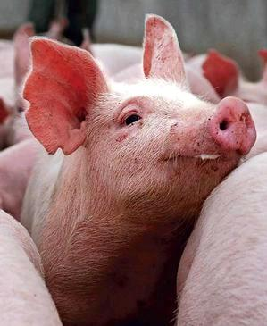
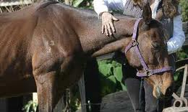
Initial Observations
Using your knowledge of the characteristics of healthy animals, evaluate the following images & classify the animal as generally healthy or not. Remember to justify your reasoning.
Notes:
Image 1 – unhealthy swine: dull eyes, dropping ears, poor color, does not appear very alert or active
Image 2 – healthy swine: bright eyes, erect ears, alert, pink “glowing” skin
Image 3 – unhealthy dog: dull eyes, drooping ears, rough, dull, patchy coat, uninterested expression
Image 4 – same dog, but healthy: bright eyes, erect ears, shiny, sleek coat, alert & responsive expression
Image 5 – healthy horse: bright eyes, erect ears, shiny, sleek coat, interested expression, active
Image 6 – unhealthy horse: dull eye, drooping head, uninterested expression, little muscle mass, dull coat

Slide 7
Vital Signs
Prove that you are still alive! List all the vital signs checked during a routine physical exam.
Notes:
The official vital signs include: heart rate/pulse, temperature, and respiration.
Capillary refill time, mucous membrane color, hydration, and body condition are also commonly used as base-line measures.
You might also review the units each vital sign is measured with, i.e. temperature is °F, pulse is beats per minute (bpm), respiration rate is breaths per minute (bpm), capillary refill time is seconds, body conditions is assigned a value 1 – 9.

Slide 8
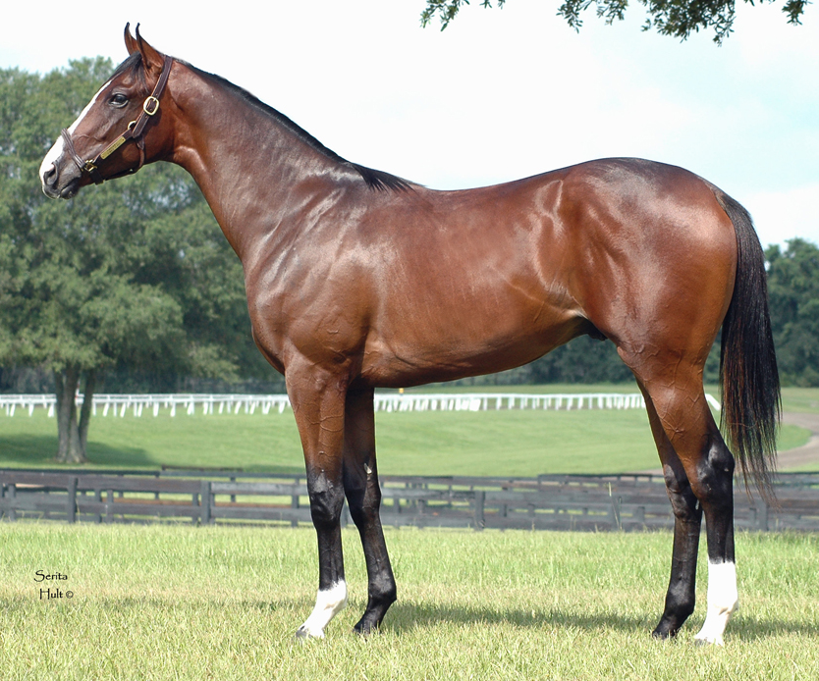
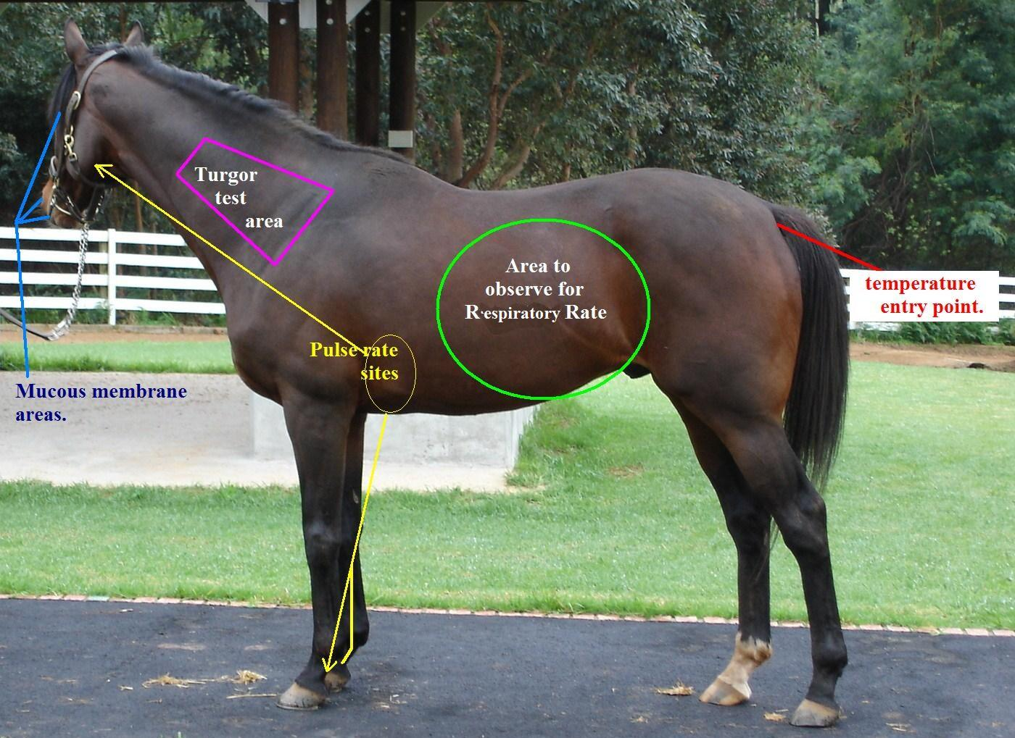
Where?
Examine the image and determine where each vital sign is measured:
Pulse
Respiration rate
Temperature
Capillary refill time & mucous membrane color
Hydration
4.
2.
1.
5.
3.
Notes:
Respiration rate
temperature
pulse rate
Hydration (turgor test or skin pinch test)
Mucous membrane (gums for capillary refill time)

Slide 9
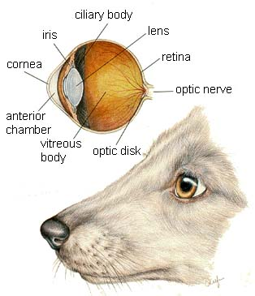
Head & Neck
How many structures in these organs can you identify?

Slide 10
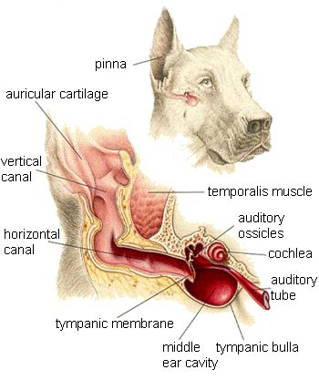

Slide 11
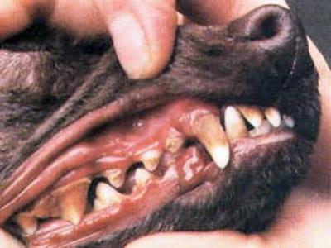
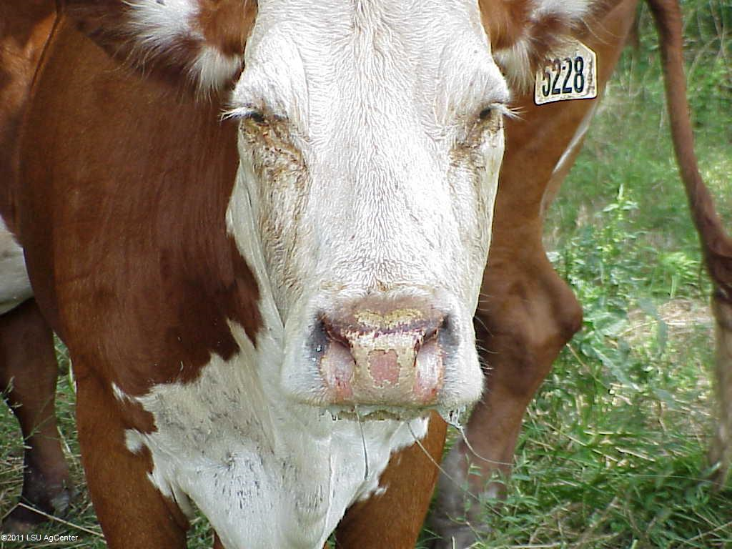
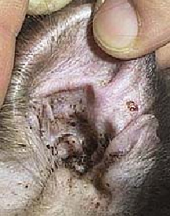
A Closer Look
Examine the following images and identify any abnormalities.
Notes:
Image 1 – dog oral cavity with inflamed gums and heavy plaque build-up
Image 2 – Hereford cow with eye discharge, inflamed eye lids, and burned muzzle from discharge
Image 3 – cat ear with black waxy discharge

Slide 12
Trunk and Limbs
Watch the videos and evaluate the horses for lameness.
Attempt to determine which leg (if any) they are lame on.
Why would lameness present more when the horse is traveling in one direction than the other?

Slide 13
Lameness Check Case Studies
Notes:
This video takes a few seconds to begin
Lame on front left leg
Note how the horse’s head goes “down on sound” or bobs as the sound leg hits the ground
It is more pronounced as the horse circles left because of the increased weight bearing in that direction

Slide 14
Lameness Check Case Studies
Notes:
No apparent lameness; note the freedom of stride and relaxed nature of the horse

Slide 15
Lameness Check Case Studies
Notes:
Lame in the left rear leg; note the short, stiff strides in his back legs, unwillingness to move, and wringing his tail; an unhappy horse

Slide 16
Respiratory Auscultation
Listen to the following breath sounds to compare and contrast normal and abnormal.
inspiration
expiration
inspiration
expiration
inspiration
expiration
inspiration
expiration
intensity
intensity
intensity
intensity
Normal
Crackles
Wheezes
Stridor
Notes:
Normal - a quiet, wispy inspiratory phase followed by a short, almost silent expiratory phase
Crackles - discontinuous, explosive, "popping" sounds that originate within the airways; heard more commonly during inspiration than expiration, imply either accumulation of fluid secretions or exudate within airways or inflammation and edema in the pulmonary tissue.
Wheezes - continuous musical tones that are most commonly heard at end inspiration or early expiration; imply decreased airway lumen diameter either due to thickening of reactive airway walls or collapse of airways due to pressure from surrounding pulmonary disease
Stridor - intense continuous monophonic wheezes heard loudest over extrathoracic airways; indicates upper airway obstruction

Slide 17
Cardiac Auscultation
Listen to the following heart sounds and compare and contrast the normal versus abnormal sounds.
normal
murmur
gallop
Notes:
You will need your speakers turned all the way up to hear the sounds well.
S1 - "Sound One" or first heart sound. The LUB in lub-dub. It is created by near simultaneous closure of the mitral and tricuspid valves.
S2 - "Sound Two" or second heart sound. The DUB in lub-dub. It is created by near simultaneous closure of the aortic and pulmonic valves.
S3 - Third heart sound or "ventricular gallop". Low in volume and in frequency (pitch). It is created by sudden tensing of the ventricular wall.
S4 - Forth heart sound or "atrial gallop". Low in volume and in frequency.
MT – Mitral, Tricuspid valves
AP – Aortic, Pulmonary valves

Slide 18
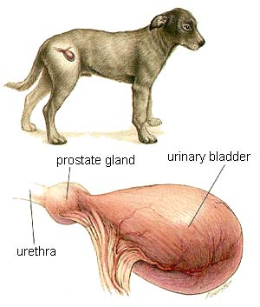
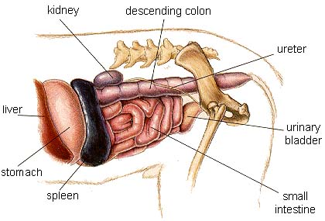
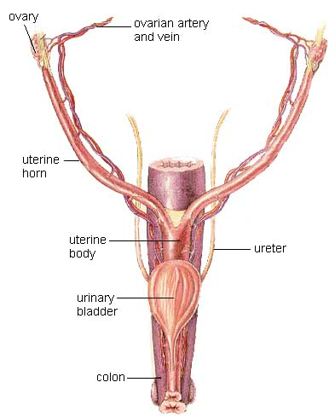
Abdomen
What organs should you be able to palpate while evaluating the abdomen?
Notes:
stomach, spleen, small intestine, kidneys, urinary bladder, prostate, uterus, colon
Images from: http://www.vetmed.wsu.edu/ClientED/anatomy/dog_ug.aspx

Slide 19
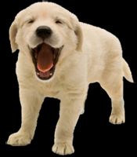
Summary
Using the “regional approach” work with a partner and describe characteristics of a healthy animal from head to tail.

Slide 20
References
http://www.ruralareavet.org/PDF/Physical_Examination.pdf
http://www.vetmed.wsu.edu/resources/restraint/index.aspx#Physical%20Examination
http://www.cvmbs.colostate.edu/clinsci/callan/index.html
http://www.monroecc.edu/depts/pstc/backup/parashs.htm
http://faculty.etsu.edu/arnall/www/public_html/heartlung/breathsounds/contents.html

