Slide 1
Dog Breeds

Slide 2
1
Powerful, sturdy, squarely built, upstanding dog of artic type, medium in size with strong muscular development and heavy bone
Clear colored, solid or solid with lighter shadings in the ruff, tail and feathering. Colors are red, black, blue, cinnamon and cream

Slide 3
2
Prime function is the control and movement of cattle in both wide open and confined areas
Color should be blue, blue-mottled or blue speckled with or without markings, or good even red speckle all over, including the undercoat, with or without darker markings on the head.

Slide 4
3
Possesses, in a most marked degree, every point and characteristic of those dogs which hunt together by scent
The colors are black and tan, liver and tan and red; the darker colors being sometimes interspersed with lighter or badger-colored hair and sometimes flecked with white

Slide 5
4
Well balanced, medium-sized dog of athletic appearance, displaying style and agility in equal measure with soundness and strength
Appears in all colors or combination of colors and or markings. Solid color, bi-color, tri-color, merle and sable dogs are all acceptable

Slide 6
5
Ideal boxer is a medium-sized, square-built dog of good substance with short back, strong limbs, and short, tight fitting coat.
Colors are fawn and brindle

Slide 7
6
Perfect bulldog is medium size and smooth coat; with heavy, thick-set, low-swung body, massive short-faced head, wide shoulders and sturdy limbs
The various colors are red brindle, all other brindles, solid white, solid red, fawn or fallow, and piebald

Slide 8
7
Short-legged dog, heavier in bone, size considered, than any other breed of dog, and while its movement is deliberate, it is in no sense clumsy
The coat is hard, smooth and short and the skin is loose and elastic. Any color and markings are common.

Slide 9
8
Sturdy hunting dog, should look like a foxhound in miniature
A close, hard, hound coat of medium length
Any true hound color

Slide 10
9
Sturdy, compact body and a cleanly chiseled and refined head, with he overall dog complete balance and ideal of size.
Colors can be black variety, any solid color other than black, parti-color variety or they can have tan points

Slide 11
10
A symmetrical, powerful, active dog, sound and well put together, not clumsy nor long in the leg, displaying a kindly expression and possessing a personality that is eager, alert and self confident
Rich, lustrous golden of various shades

Slide 12
11
Have long, luxurious blue and tan coats.
Coat is parted on the face and from the base of the skull to the end of the tail and hangs evenly and quite straight down each side of body.

Slide 13
12
Dignity, strength and elegance with great size and a powerful, well-formed, smoothly muscled body.
Colors are brindle, fawn, blue, black, harlequin, and mantle

Slide 14
13
A compact and solid dog, its long, flowing double coat is its most distinctive feature.
All colors are seen with this breed

Slide 15
14
Strongly built, medium-sized, short-coupled, possessing a sound, athletic, well-balanced conformation
Coat colors are black, yellow and chocolate

Slide 16
15
Medium large, robust and powerful dog, black with clearly defined rust markings.
Very protective of their territory and do not welcome strangers.

Slide 17
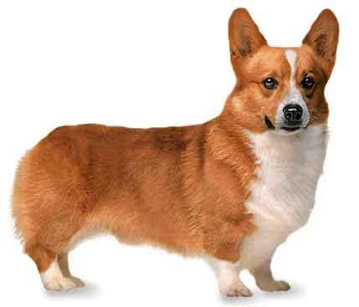
16
Low-set, strong, sturdily built and active, giving an impression of substance and stamina in a small space
Coat can be red, sable, fawn, black, and tan with or without white markings

Slide 18
17
Low to ground, long in body and short of leg, with robust muscular development; the skin is elastic and pliable without excessive wrinkling
Three varieties of coats: smooth, wirehaired and longhaired

Slide 19
18
Small, hardy breed with a beautiful cloak of hair that parts down their back from head to tail
All colors are accepted with or without dark tips to ears and beard
Coat is very dense and of a good length

Slide 20
19
Very active, intelligent and elegant-appearing dog, squarely built and well proportioned
The coat is an even and solid color of white, black, apricot and gray.

Slide 21
20
Compact, short-backed, active toy dog
Cocky, commanding and animated as he gaits
All color, patterns and variations are seen in this breed

Slide 22
21
Essentially a working Collie in miniature.
Rough-coated, longhaired working dog
Coat can be black, blue merle or sable, marked with varying amounts of white and/or tan.

Slide 23
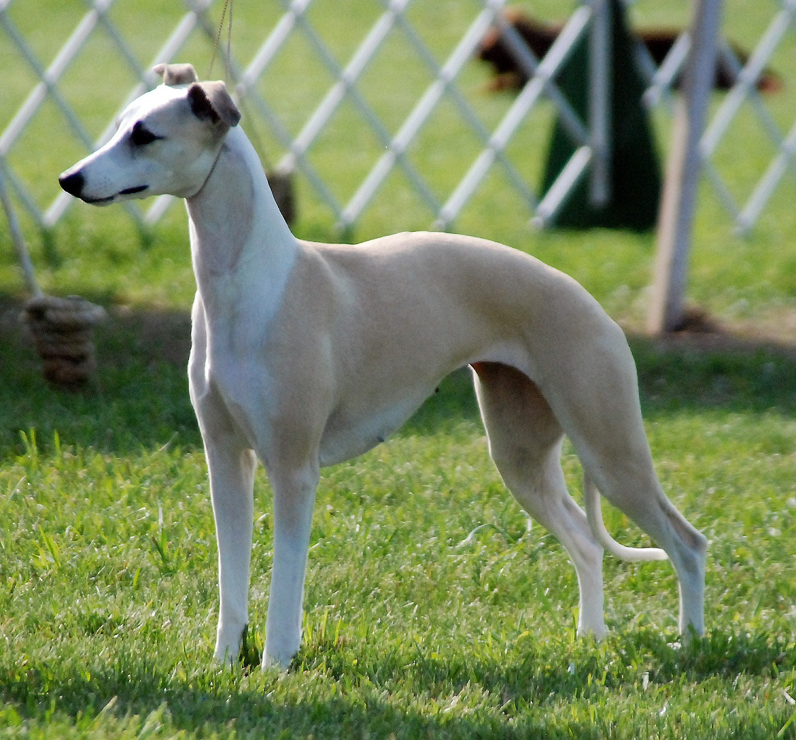
22

Slide 24
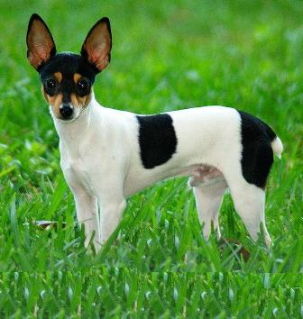
23

Slide 25
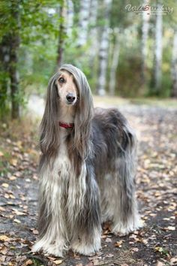
24

Slide 26
Cat breeds

Slide 27
25
Medium sized cat with a rounded head, expressive eyes and a sweet disposition
Many colors are recognized, but the 4 main ones are sable, champagne, blue and platinum

Slide 28
26
Soft, wavy, curly hair
Coat feels like crushed velvet to the touch
Slender, racy bodies
Found in a wide variety of colors and patterns

Slide 29
27
Best known for its distinctive ears, which are folded forward and down, and by its large rounded eyes
Great number of colors and patterns

Slide 30
28
Medium sized, alert animals with an elegant appearance and a sweet, open expression complimented by their remarkable ears
Available in long haired and short haired and come in any color or coat pattern

Slide 31
29
Available in a veritable rainbow of colors and patterns
Most popular and perhaps the most recognized breed of cats

Slide 32
30
Noted for its short, plush, silvery blue coat, brilliant green eyes and semi-foreign body type with long legs and body
Solid silvery blue coats

Slide 33
31
Head is slightly longer than it is wide, ears are wide at the base, moderately pointed and well tufted inside
Wide range of colors and patterns
Tail is as long as torso

Slide 34
32
Stocky, solid cat with a dense double coat, a compact body, very short back, hind legs that are visibly longer than front legs, big bones, wide chest and greater depth of flank
All colors and patterns exist in both coat lengths

Slide 35
33
Balanced medium sized animal of foreign type.
Beautiful ticked, resilient coats
Four common colors: Ruddy, Red, Blue and Cream

Slide 36
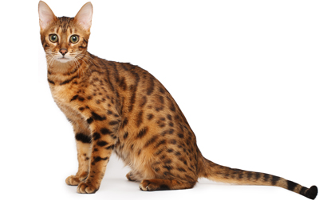
34

