Slide 1
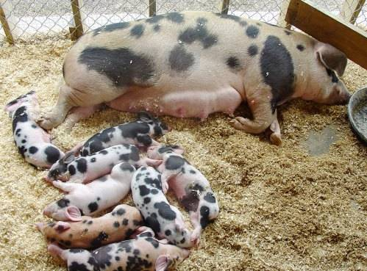
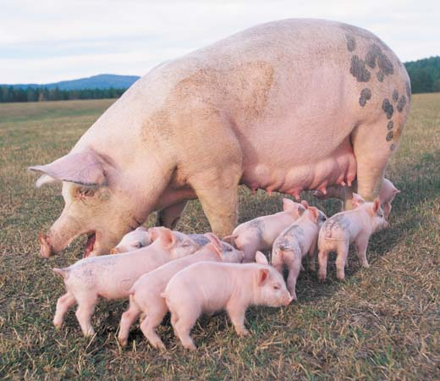
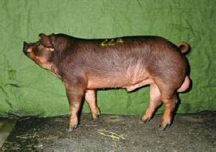
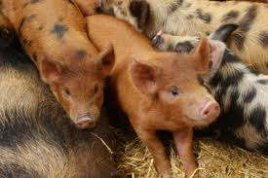
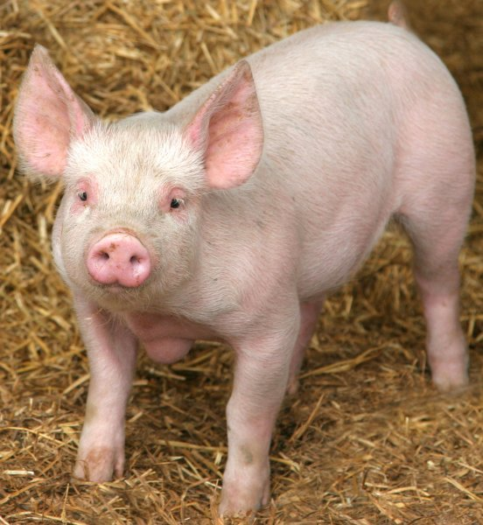
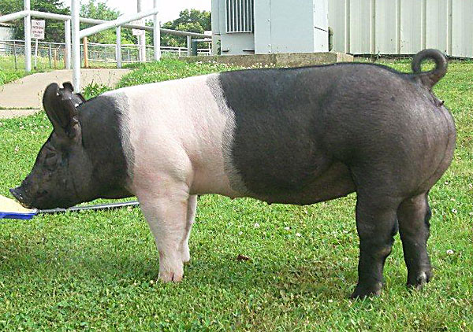
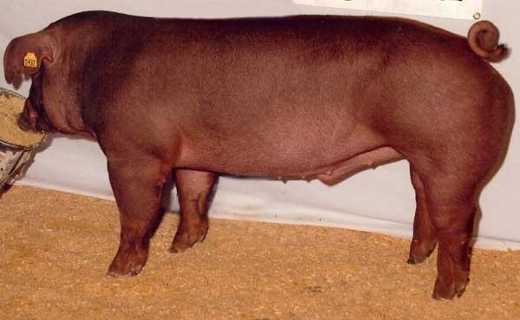
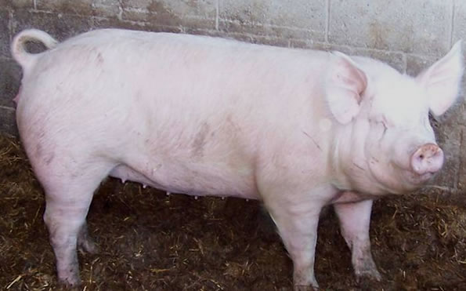
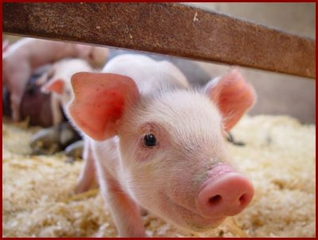
Swine Breeds

Slide 2
American Landrace
Originated in Denmark
White in color with huge drooping ears
Longer than other breeds because of extra vertebrae
More confinement adaptable

Slide 3
American Yorkshire
Originated in England
White with erect ears
“Mother breed”- large litters and excellent milking, and mothering ability
Muscular with high proportion of lean meat

Slide 4
Berkshire
Originated in England
Black color, white points and nose
Short faced with erect ears
Early-maturing
Juicy, flavorful, tender meat

Slide 5
Chester White
Developed in the United States
White hair with drooping ears
Large litters and excellent mothering ability

Slide 6
Cross/ Blue Butt
Cross between any black breed and any white breed
Usually a Yorkshire and Hampshire cross

Slide 7
Duroc
Developed in the United States
Reddish brown in color
Drooping ears
Quick muscle growth
Aggressive

Slide 8
Hampshire
Developed in the United States
Black with a white belt and erect ears
Well-muscled, rapid growers
Excellent mothers
Good tempered
Good carcass quality

Slide 9
Hereford
In order to be registered in the Herford Hog Record Association, they must have a white face, not less than two-thirds red exclusive of face and ears, with at least two white feet-white showing not less than one inch above the hoof.

Slide 10
Pietrain
Originated in Belgium
Black and white spotted with erect ears
High proportion of lean to fat
Often carries the gene for Porcine Stress Syndrome
Purebreds are rare, instead used in crossbreeding programs

Slide 11
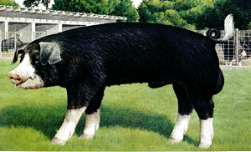
Poland China
Developed in the United States
Black with white patches, drooping ears, and large size
Maximum weight at any given age
Excellent feeders – gain readily
Quiet nature and hardy constitution

Slide 12
Red Wattle
Large, red hog with a fleshy wattle attached to each side of the neck
Known for hardiness, foraging activity, and rapid growth rate

Slide 13
Spotted Swine
Developed in the United States
Black and white spotted with drooping ears
Able to transmit their fast-gaining, feed efficient, meat qualities to their offspring

Slide 14
Tamworth
From England
Head is long and has a snout that is moderately long and quiet straight
Very practical red coat. The color may vary from a golden red to a dark red.

Slide 15
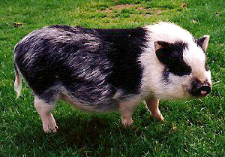
Vietnamese potbelly
Developed in Vietnam
Average 3-ft long, 15-inches tall, and 70 – 150 lbs
Solid black to solid white with a variety of spots
Used as pets

